Slide 1




DIGITAL LITERACY
SKILLS
ADVANCED USERS

Slide 2
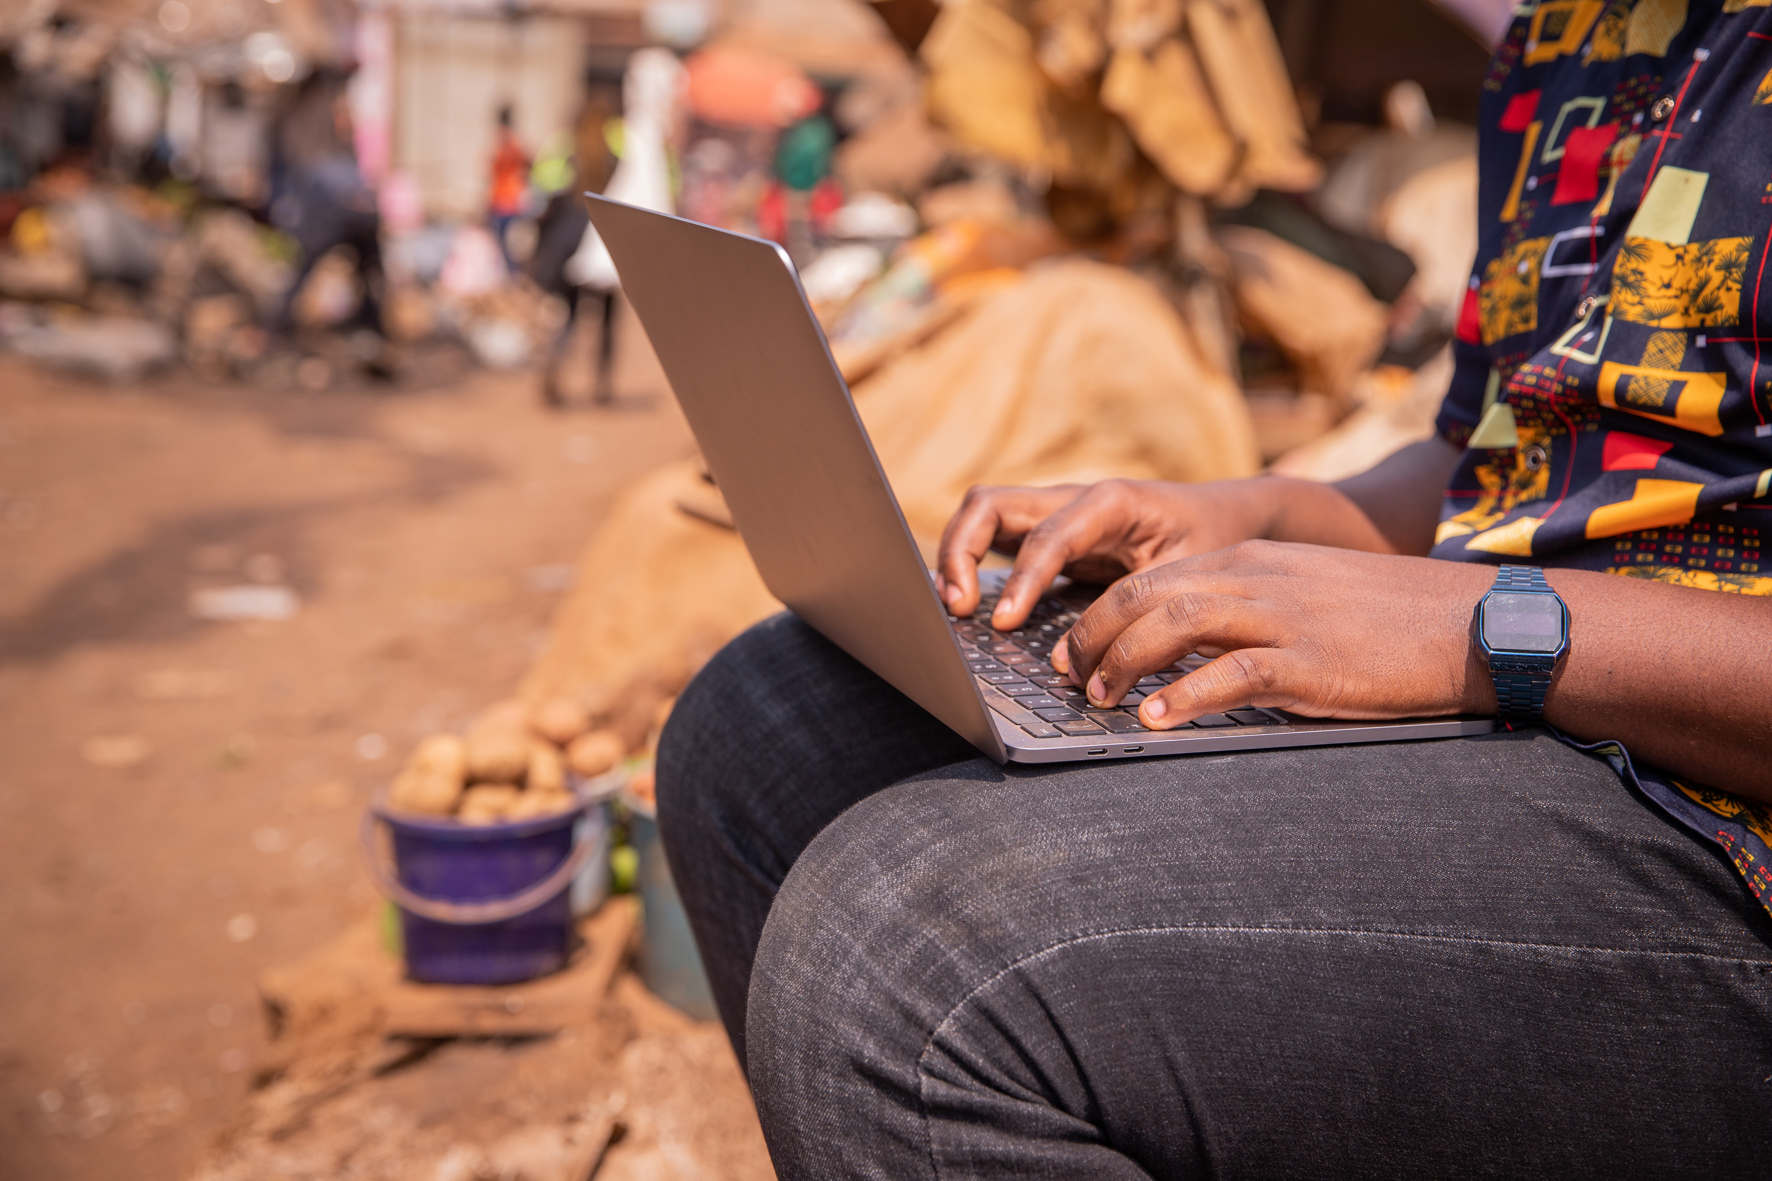
Module 3
Communication
and collaboration

Slide 3

5
Unit 5: Netiquette

Slide 4
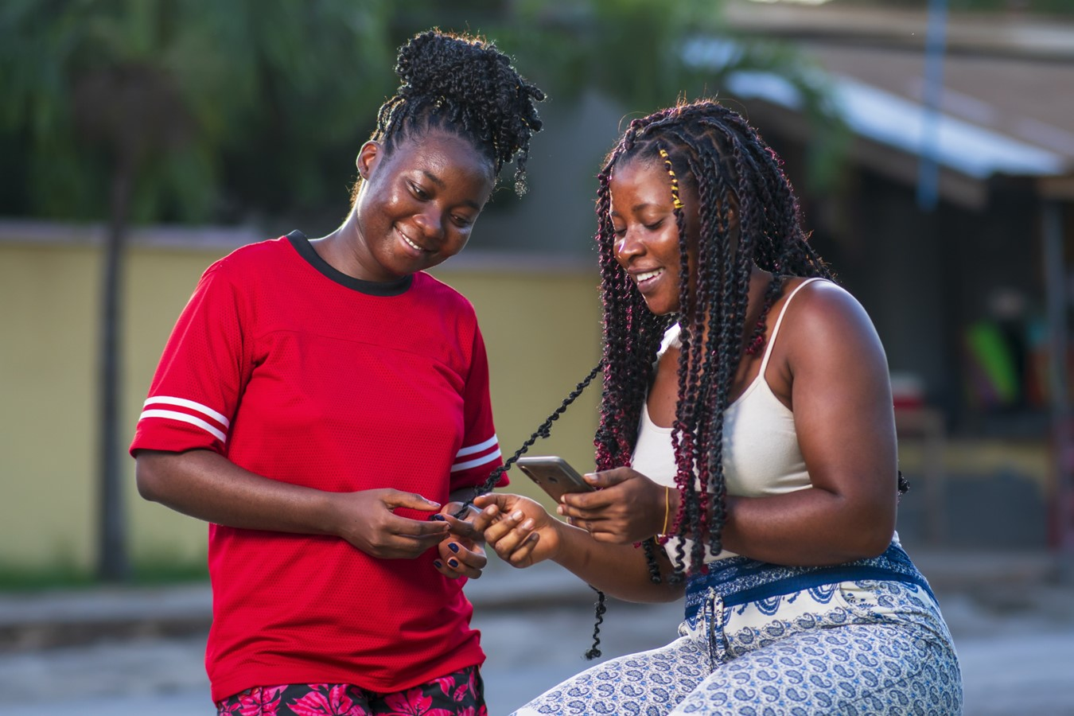
What does netiquette mean?
Netiquette is the online equivalent of etiquette. It is a way of behaving that respects and upholds the dignity and humanity of the people you are interacting with online.

Slide 5
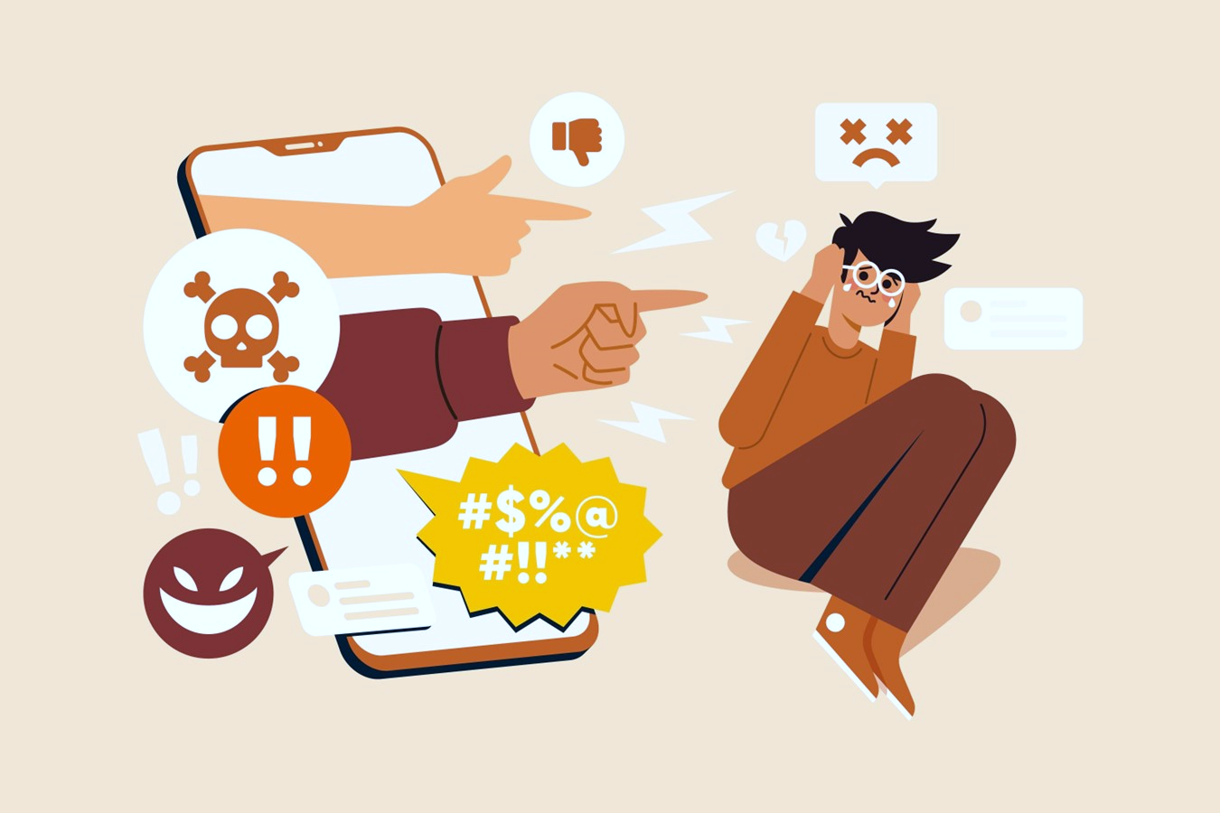
What to avoid when applying netiquette
Bad netiquette includes all online behaviours that are disrespectful towards others.

Slide 6
What to avoid when applying netiquette
Disrespecting intellectual property: Sharing content of others without citing the source.
Not respecting other people's opinions: Adopting hostile and insulting attitudes.
Expressing ourselves in a disrespectful way: When writing be aware of how you write and how you express yourself and your ideas.
Disrespecting the privacy of others: Never share sensitive data without the other person's permission.

Slide 7
Skills to practise
Adapt the most appropriate behavioural norms and knowledge while using digital technologies and interacting in digital environments.
Set up a follow-up meeting to the Zoom or Skype meeting mentioned in the previous unit.
Use this second meeting to discuss behaviours that happened previously that may not be acceptable netiquette.
Talk about what behavioural changes will be needed to that the same thing does not happen in a future meeting.

Slide 8
All back covers should include
contact information of the section
producing the work.
© United Nations Children’s Fund (UNICEF) [month and year of publication]

